Slide 1
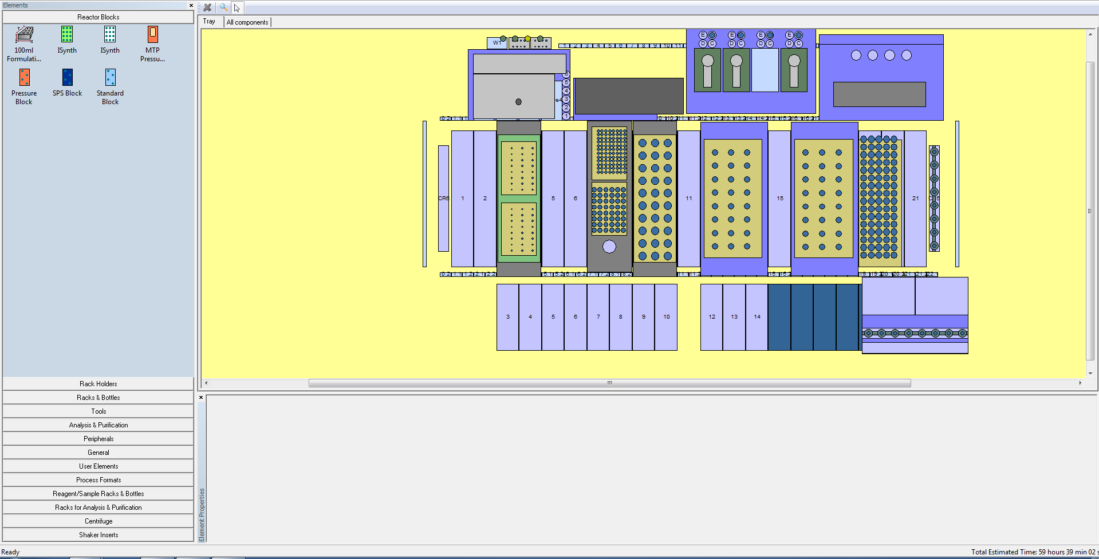
8
10
9
4
3
1
2
5
6
6
7
Chemspeed NMR Rack
(holds two housemade NMR racks).
Vial rack (holds a 60mL vial filled with CH₂Cl₂).
One 1mL, two 20mL syringes and their
actuators. This is the liquid backbone.
1
5
9
Chemspeed MTP holder (it’s a rack that
Holds MTP style plates).
Shaker rack (holds 32 (20mL) stock solution
vials, has the option to hold 48 vials).
10
Crimper head (not used
in project).
2
6
3
Waters plate (holds 48 LCMS vials).
7
Heater rack (holds 48 (8mL) reaction vials,
has the option to hold 80 vials).
Mosquito plate (holds 96 different 3 microlitre wells) .
8
Needle head.
4

